Slide 1
Find breast cancers in screening mammograms
By: Sachit Nair (20BRS1140) and Harisha S ( 20BRS1127)

Slide 2
Problem Statement
To build a model that is able to accurately identify the presence of breast cancer in a screening mammogram.
The goal of this challenge is to accurately identify instances of breast cancer by training a model with mammograms obtained from routine screenings. By improving the automation of mammogram analysis, we can help radiologists increase their accuracy and efficiency, leading to improved patient care that is both safe and of high quality. Additionally, this may result in reduced costs and fewer unnecessary medical procedures

Slide 3
Approach and Explanation
In our previous review, we touched on the following ideas which we could implement in making our model
Crop the images to a lower size and to a specific format such as JPEG as it was mentioned that there isnt an uniformity in the input data. The cropping can be used to remove the approximate regions where the breast image is unlikely to be present like the sides of the scan. This reduces size of the image, eliminates unnecessary computation and increases accuracy of the model
The breast scans are taken in two views- CC and MLO. For the CC view, the breast is compressed from "head to toe" while for the MLO view, the breast is compressed "side to side" at an angle. This is repeated for each breast. So in total, there are 4 images. Presence of breast cancer is determined for each breast, so concatenating the CC and MLO views for each laterality can give more detail of the patient
While training, the machine id, should be grouped alongside patient id. The images taken are sensitive to the machines from which it is taken. So appropriate methods for this must be considered while training
A custom CNN network to be trained with input image concatenated with data such as machine id, patient id, laterality, etc. Transfer learning can be used for the same, and models like ResNet, InceptionNet and DenseNet can be used as they have a good history for predicting cancer.
On the contrary, Unsupervised learning can be also be employed. Clustering and dimensionality reduction, can be used to identify patterns in the data without using labels. These patterns to create a heatmap of the image, highlighting regions that are different from the rest. This may provide some indication of location of cancer which can inturn be used to predict probabilities of cancer.

Slide 4
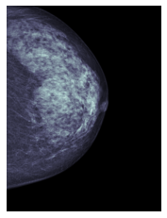
Cropping the Image
As we have already observed, only a fraction of the total image contains the mammogram. Due to this, we will be unnecessarily spending a lot of computational power on the parts of images which doesn’t provide us with reasonable features for identifying the presence of cancer. Whereas, the possibility that this extra pixels can serve as noise is highly likely. We have overcome this by employing a function called as crop
In order to crop an image, we need to understand the pixel rows or columns where the information gain is maximum, i.e, not filled with dark regions which is indicative that the row/column is background. This is achieved through the use of functions- get_x_offset and get_y_offset

Slide 5
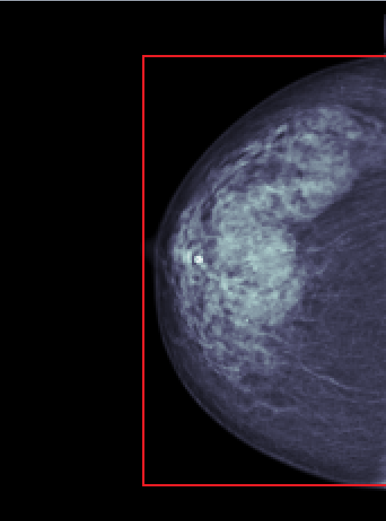
Cropping the Image
These functions initially apply a smooth filter throughout the image, and calculate the sum of all values in the row or column depending on whether it is the x_offset or the y_offset. The maximum sum in this 1D array is then taken to approximate the minimum threshold of values we can look for in the array which will give us the indexes where our mammogram is localized.
On observing the mammograms, it is noticed that the scan is localized in the right/left side at the centre. This tells us that the image must be cropped from both the top and bottom sides, but x-axis crop need to be only from either of the image sides.
Region to be cropped to

Slide 6
Cropping the Image
def get_x_offset(image, max_col_sum_ratio_threshold=0.05):
# set the margin to 0
margin = 0
# calculate the sum of pixel intensities along the columns and smooth the resulting vector
sums = smooth(image.sum(axis=0).squeeze())
# calculate the index of the column with the maximum sum within the first 75% of the image width
sums_argmax = sums[:int(image.shape[1] * 0.75)].argmax()
# calculate the sum threshold for the columns based on the maximum sum and the given ratio threshold
sums_threshold = sums.max() * max_col_sum_ratio_threshold
# set a flag to check if the first non-zero column has been found
first_non_zero_column_found = False
# loop over the column sums with their corresponding indices
for offset, s in enumerate(sums):
# if the current column sum is below the threshold and the first non-zero column has been found, then the index where the breast region ends has been found
if s < sums_threshold and first_non_zero_column_found:
# return the minimum of the image width and the offset plus the margin
return min(image.shape[1], offset + margin)
# if the current column sum is above the threshold and the current index is greater than the index of the maximum sum
elif s > sums_threshold and offset > sums_argmax:
first_non_zoro_column_found = True
# if no offset is found, return the offset (0)
return offset

Slide 7
Accounting for various views- MLO and CC
We didnt train separate models for MLO and CC, or add this detail to the model separately. During training, there was no distinction between both views, while testing the model classifies on both the views, and the average of the value is taken.
for (patient_id, laterality), g in tqdm(test.groupby(['patient_id', 'laterality'])):
cancer = 0
for row_idx, row in g.iterrows():
# Load Image
image_id = row['image_id']
image = cv2.imread(f'{image_id}.png', -1)
# Expand to Batch HxW -> 1xHxWx1
image = np.expand_dims(image, [0, 3])
# Make Prediction
cancer += model.predict_on_batch(image).squeeze() / len(g)
For each laterality (Left/ Right Breast), predictions are run for both the views in order to calculate the final prediction.

Slide 8
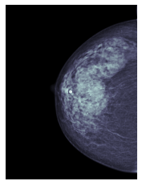
Flipping the Images
Due to laterality, the mammograms are localized in the left side of the image for a few, and right side for another. As our aim is to just determine whether breast cancer is identified in a mammogram, leaving this detail as it is can cause unnecessary complication. So, we decided to flip the image so that the breast is located on the same side of the image throughout our set.
Flipping the images to maintain uniformity

Slide 9
Border Noises
Moreover, it is studied that cropping of the image doesn’t account for border noise or lines which might be present in the mammogram, to omit this information, about 10 pixels from each side is cropped off.
image = image[int(h0 * 2e-2):-int(h0 * 2e-2),int(w0 * 2e-2):-int(w0 * 2e-2)]
The line removes 2% of the height and width of the image to omit border noises and lines

Slide 10
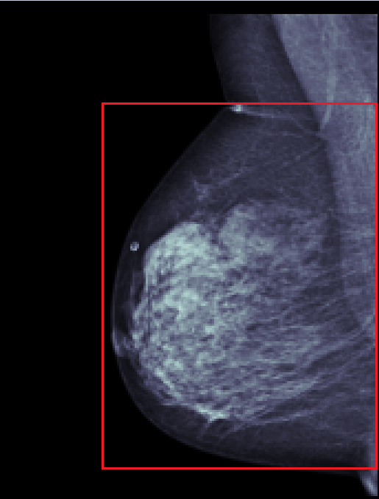
Resizing
Once the image is cropped, it is resized to the target height-width ratio through padding. A resize function to our Target Height and Width was avoided because that can result in expanding and shrinking of dimensions which will incorporate faulty features into our system. So, only the height-width ratio is maintained. While training the model, the image is later scaled down without any impacts to its actual pixel content.
Dissimilarity in cropping ratios will result in loss of information and possible noise in the Inputs.

Slide 11
Resizing
if size is not None:
# Get current image dimensions
h, w = image.shape
# If height/width ratio is greater than target ratio, pad width to make square image
if (h / w) > TARGET_HEIGHT_WIDTH_RATIO:
pad = int(h / TARGET_HEIGHT_WIDTH_RATIO - w)
image = np.pad(image, [[0,0], [0, pad]])
h, w = image.shape
# Otherwise, pad height to make square image
else:
pad = int(0.50 * (w * TARGET_HEIGHT_WIDTH_RATIO - h))
image = np.pad(image, [[pad, pad], [0,0]])
h, w = image.shape

Slide 12
Other Details Included
Threads set to 1 for Tensorflow and CV2 to increase the overall speed of the program. We have chosen this because multiple threads can create a lot of overhead because of synchronizing and shared resource management process. Also, Our primary framework is tensorflow which is not optimized for distributed computing as much as Pytorch- which is another reason for our choice.
We are setting the target height and width of our mammograms to be 1344 and 768 respectively. While reading the images, we have set te number of channels to 1 as they are grayscale images. Later on, it is changed to a depth of 3 while training the model
CLAHE filter was applied to the cropped and resized images before it was finally saved because it improves the contrast and the visibility of features.

Slide 13
Steps (Initial)
Read the DICOM file
Convert into pixel array for further processing. In case of type Monochrome1, then the image must be inverted.
05
Resizing the Image
Maintaining the target height-width ratio by padding
01
04
Cropping the Image
Localizing the breast cancer/ mammogram region in the image
Flipping of Images
For a generalized model- no disparity between right and left breast cancer detection as underlying principles are same
02
03
Removing Border Noise
Cropping out 2% of the image to reduce any noises and lines that may exist in the image

Slide 14
Model Used- EfficientNet V2
EfficientNet V2 is an advanced neural network that improves on the original EfficientNet by achieving higher accuracy with fewer parameters and FLOPS ( (floating-point operations per second). It uses advanced techniques for better performance on computer vision tasks.
It uses a compound scaling technique to optimize the model's depth, width, and resolution simultaneously. It consists of a stack of convolutional layers, followed by batch normalization and activation functions.

Slide 15
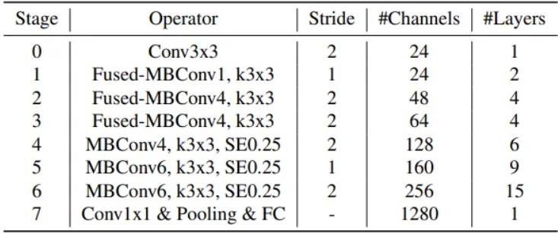
Architecture of the model

Slide 16
Features that make this model special
MBConv (Mobile Inverted Bottleneck Convolution) block is a key building block used in EfficientNet V2 that balances the trade-off between model accuracy and computational efficiency. It consists of a depthwise separable convolution followed by a linear bottleneck and a shortcut connection. The depthwise separable convolution reduces the number of parameters and computation cost, while the linear bottleneck expands the dimensionality of the features and increases the representational power.
A fused MBConv block is a modified version of the Mobile Inverted Bottleneck (MBConv) block used in EfficientNet V2 that combines multiple operations into a single convolutional layer.

Slide 17
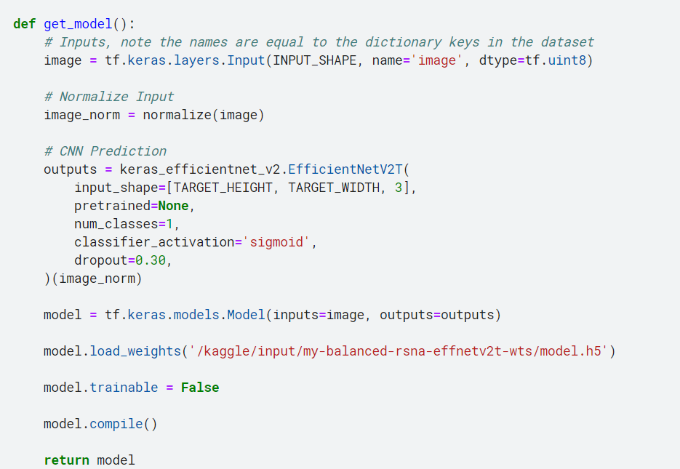
The overall model

Slide 18
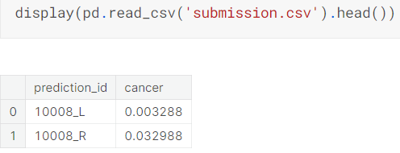
Code / Implementation
Kaggle Notebook Link
The above link contains the code that implements the approach. Run using GPUs.
The output is of the format attached below:

Slide 19
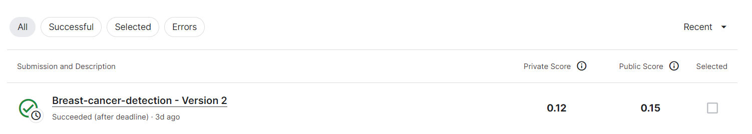
Submission Result

Slide 20
Improvements Suggested
Using publicly available mammogram datasets to further enhance the model as the Kaggle contest dataset is set to be biased yielding poor results
Combining machine_id along with the patient_id as this could result in some significant information gain
Experimenting with unsupervised learning, and transfer learning approaches
Making separate models for MLO and CC scans, and later combining the results obtained from both the models to get the final prediction

Slide 21
Other Options Considered
As per our initial idea, we wanted to pursue on utilizing unsupervised learning which could extract features from the mammogram images, and use this to determine the presence or absence of breast cancer. The following research article gave us an insight on how this can be achieved, but we were unable to proceed further due to knowledge gap:
“Kallenberg, M., Petersen, K., Nielsen, M., Ng, A. Y., Diao, P., Igel, C., ... & Lillholm, M. (2016). Unsupervised deep learning applied to breast density segmentation and mammographic risk scoring. IEEE transactions on medical imaging, 35(5), 1322-1331.”
Their approach consisted of generating multiscale image patches as input data, processing them through a multilayer convolutional architecture, and learning the representation parameters using a sparse autoencoder with a novel sparsity regularizer.

